Slide 1

Introduction to Phishing Awareness
Title:
Phishing Awareness Training
Subtitle:
Stay Safe Online
Objective:
Understand phishing tactics and learn
how to protect yourself and your organization.

Slide 2
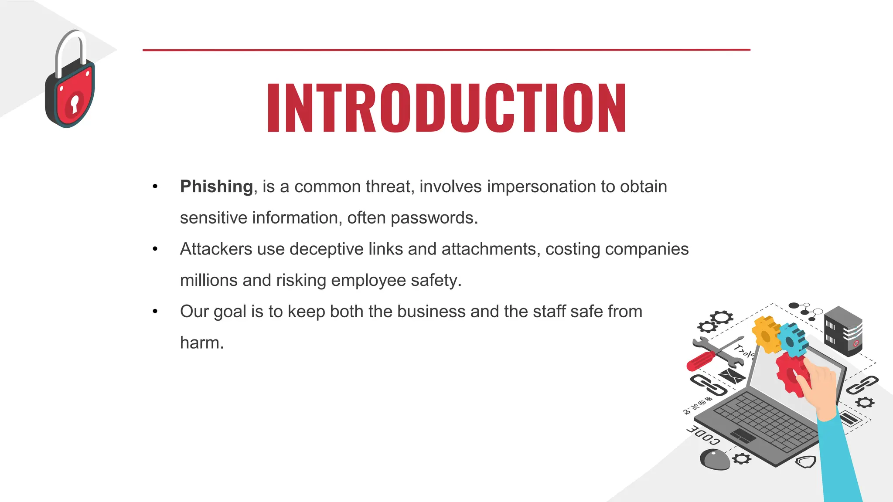
What is Phishing?
Definition:
Phishing is a cyberattack where attackers disguise themselves as
trusted entities to deceive individuals into providing sensitive
information.
Examples of Phishing:
Fake emails, websites, text messages, or phone calls.

Slide 3
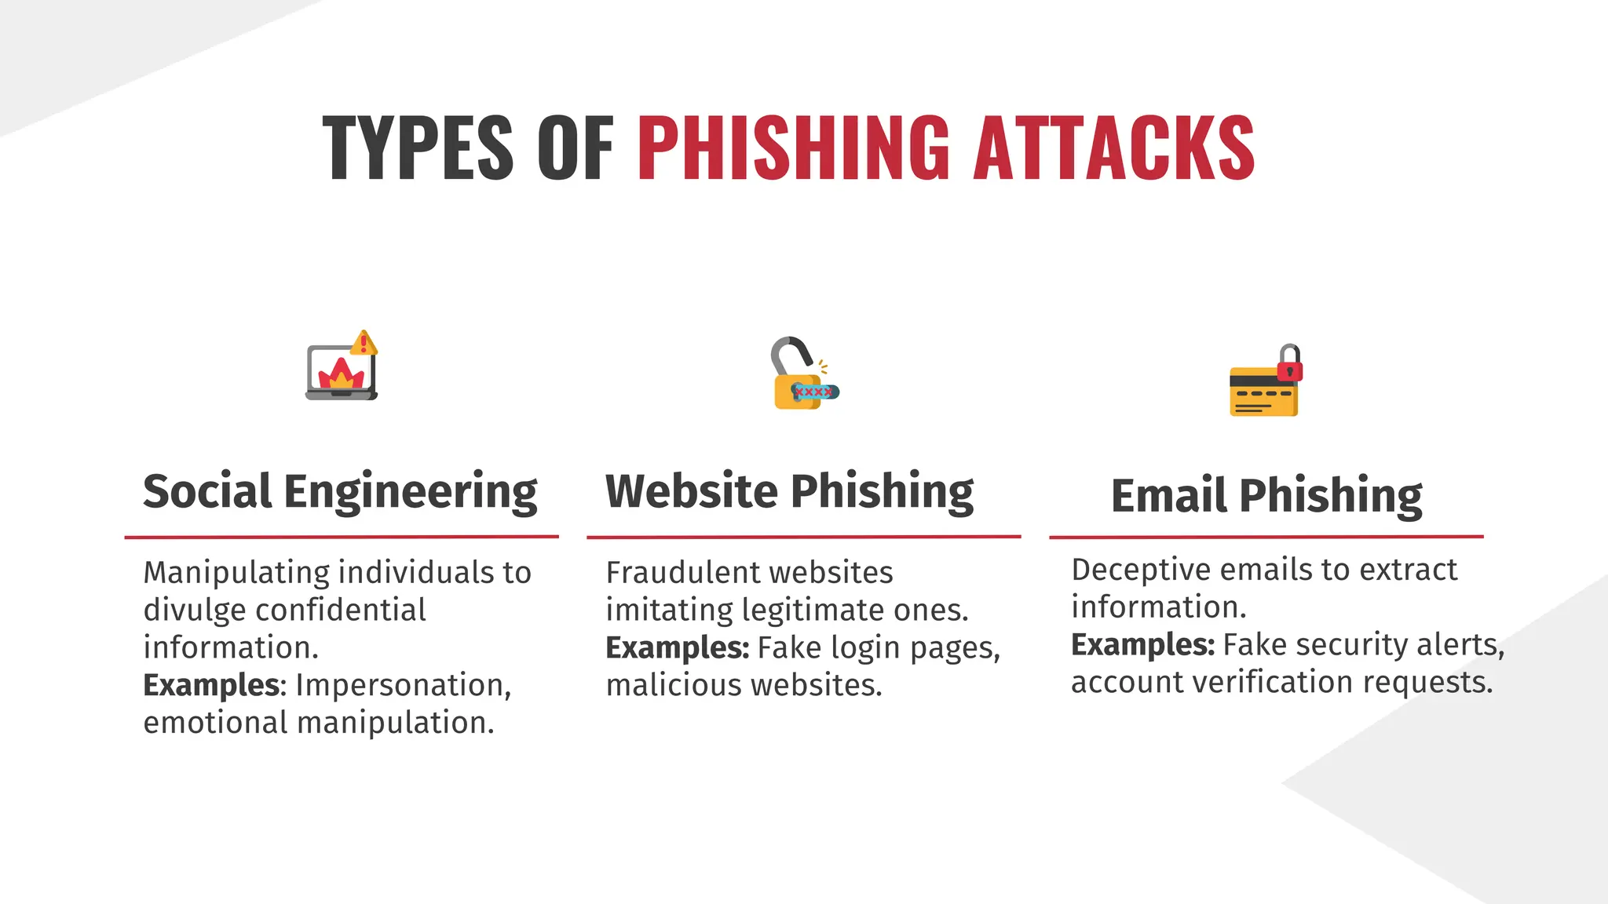

Slide 4
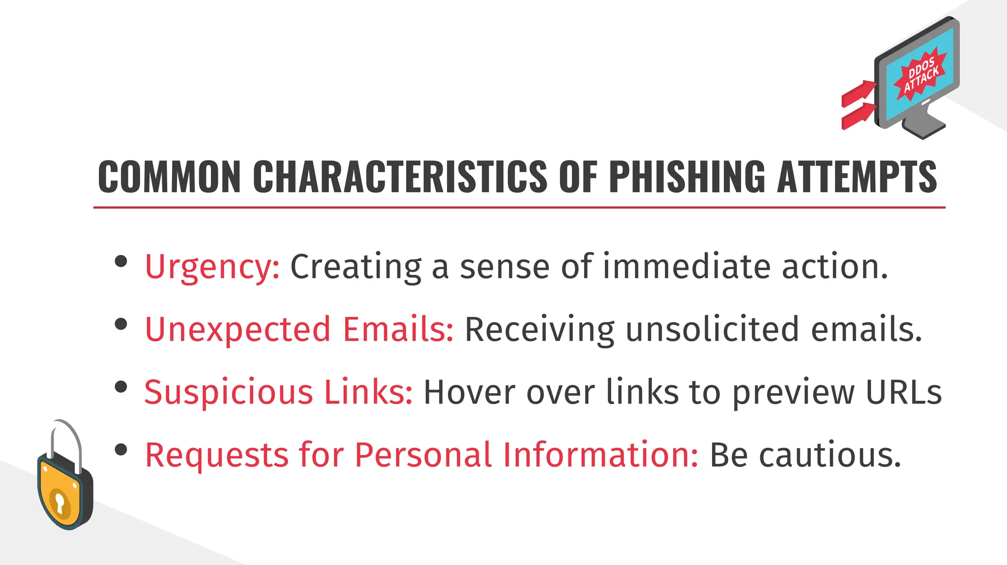

Slide 5
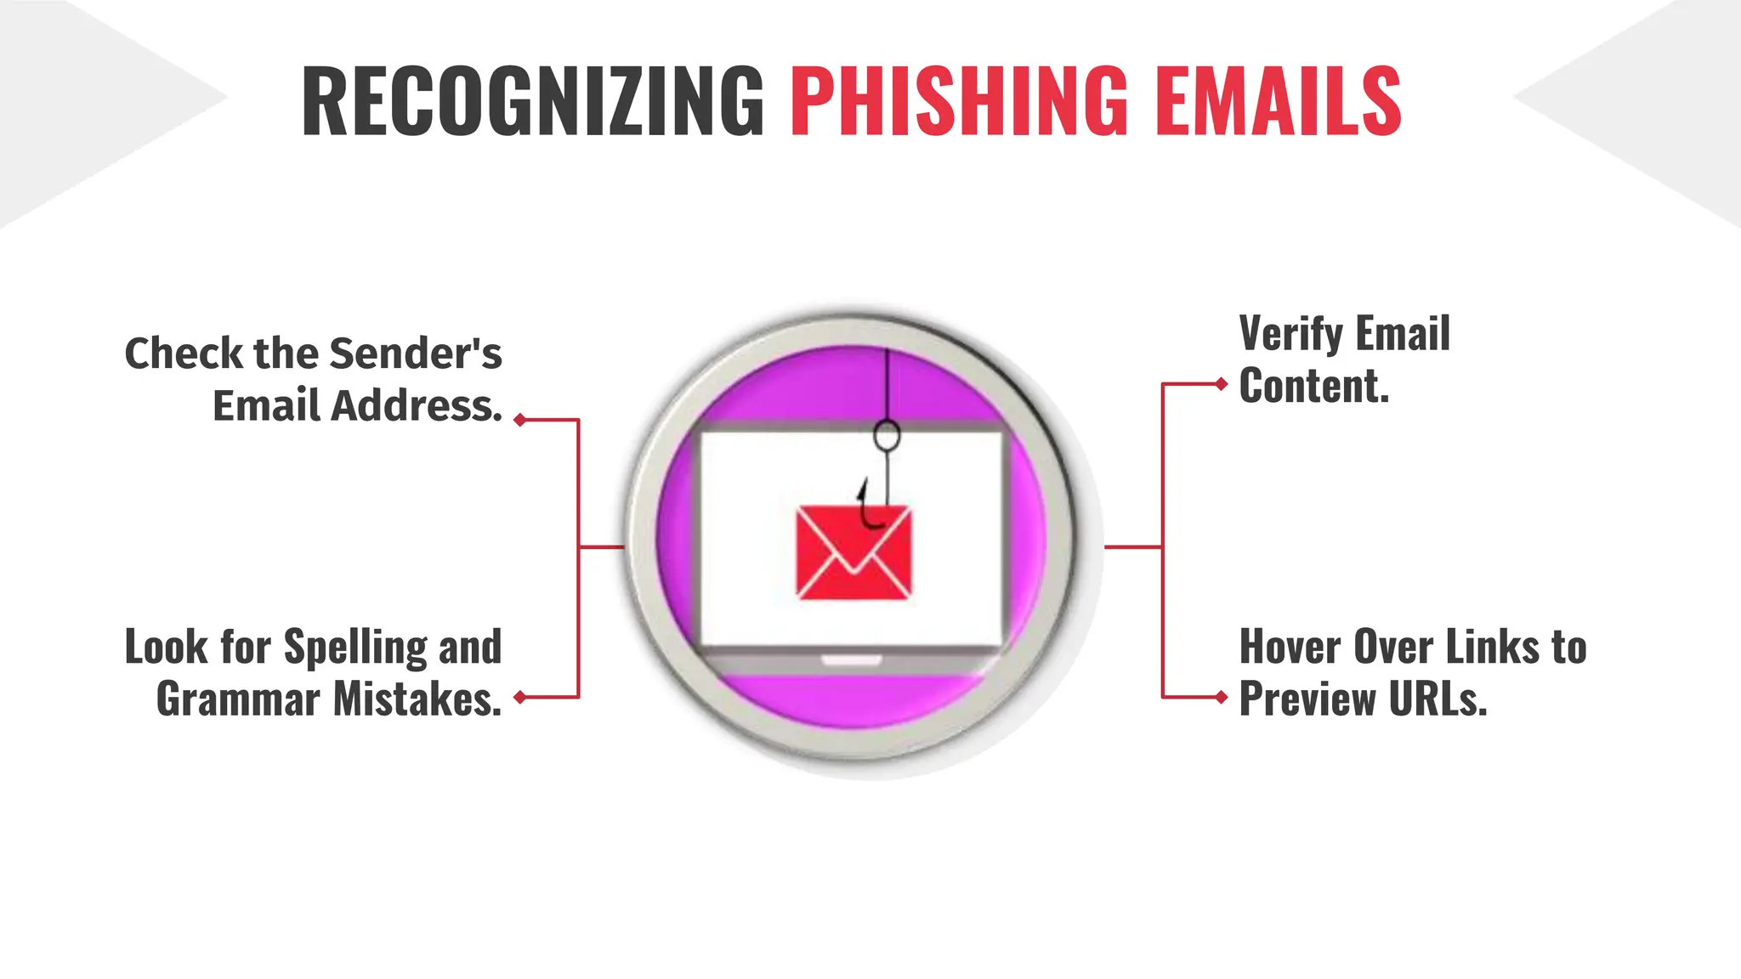

Slide 6
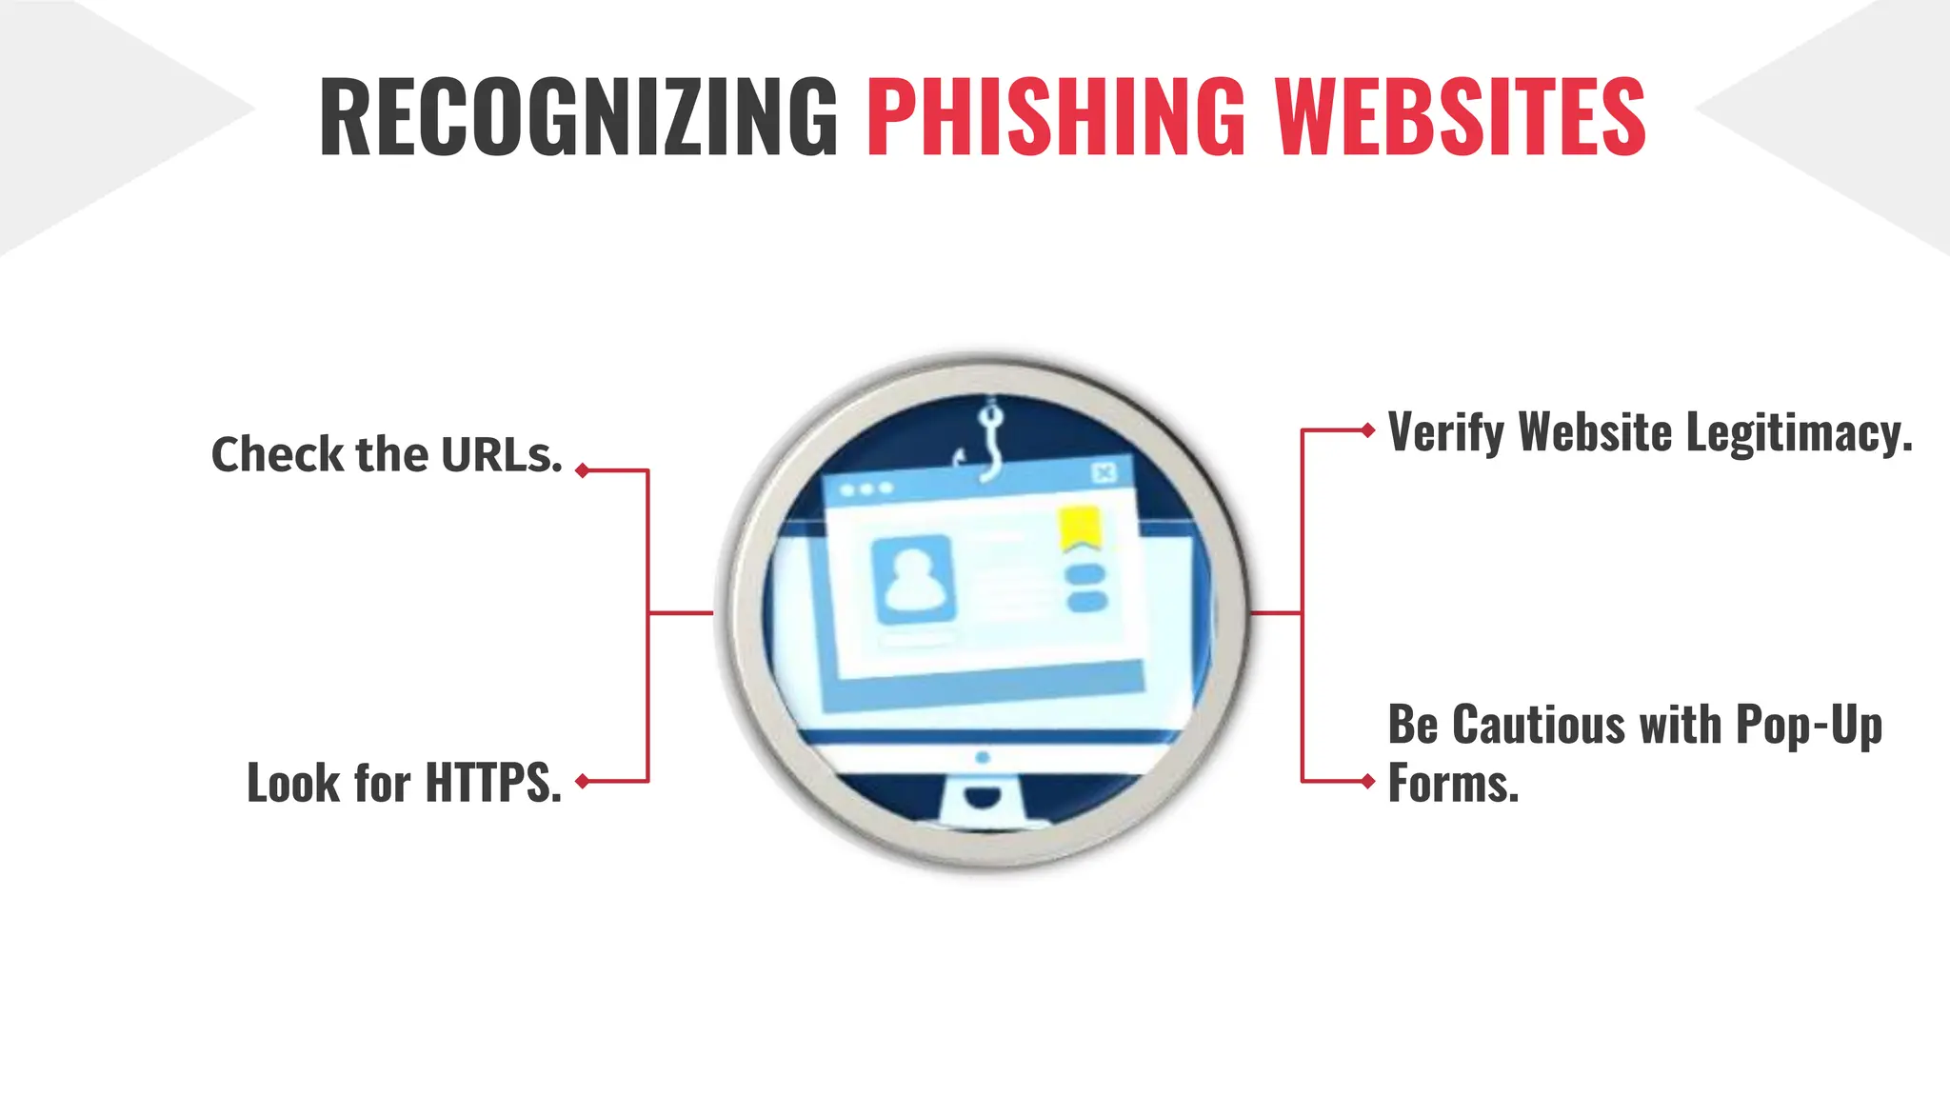

Slide 7
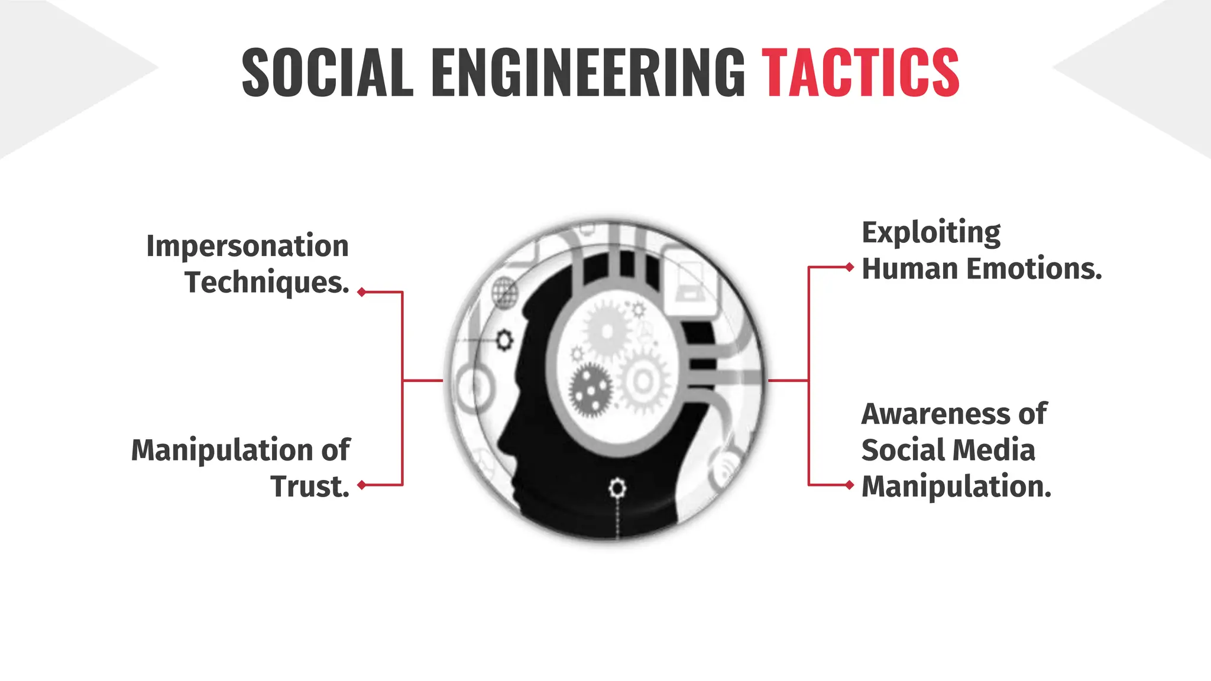

Slide 8
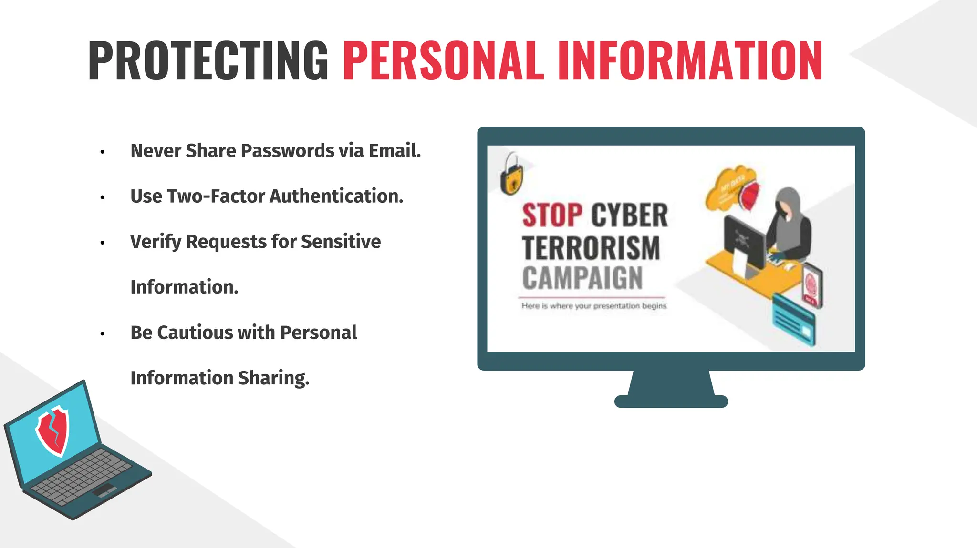

Slide 9
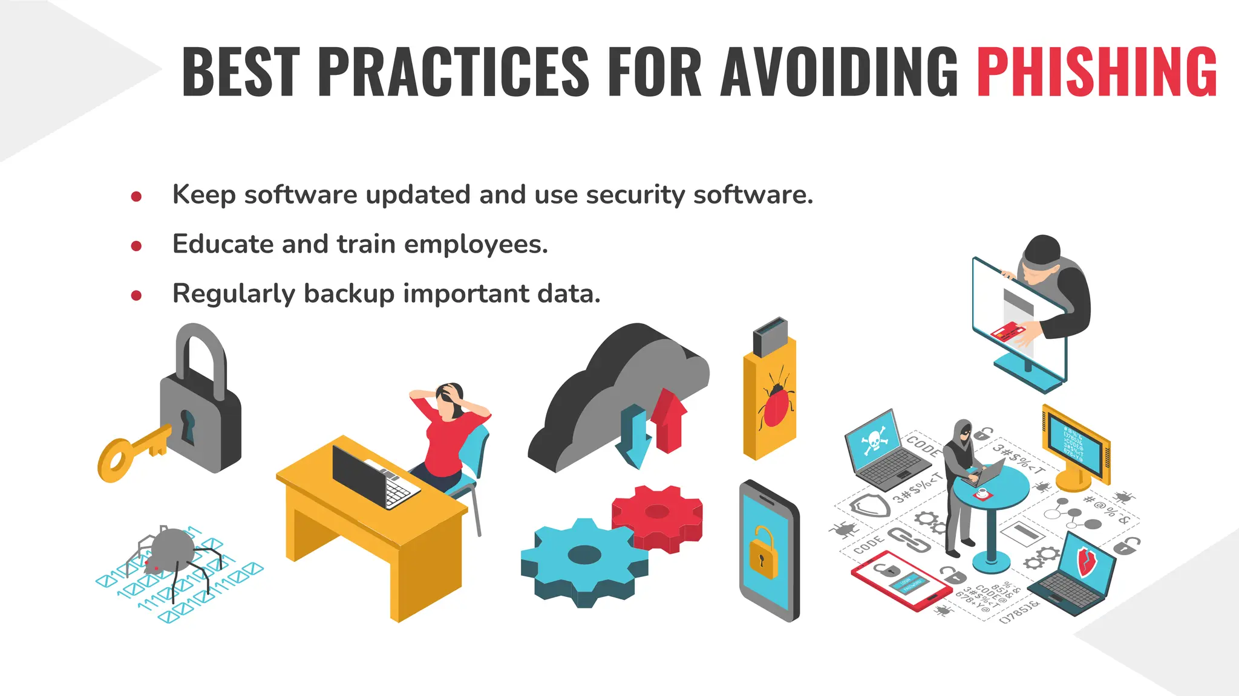

Slide 10
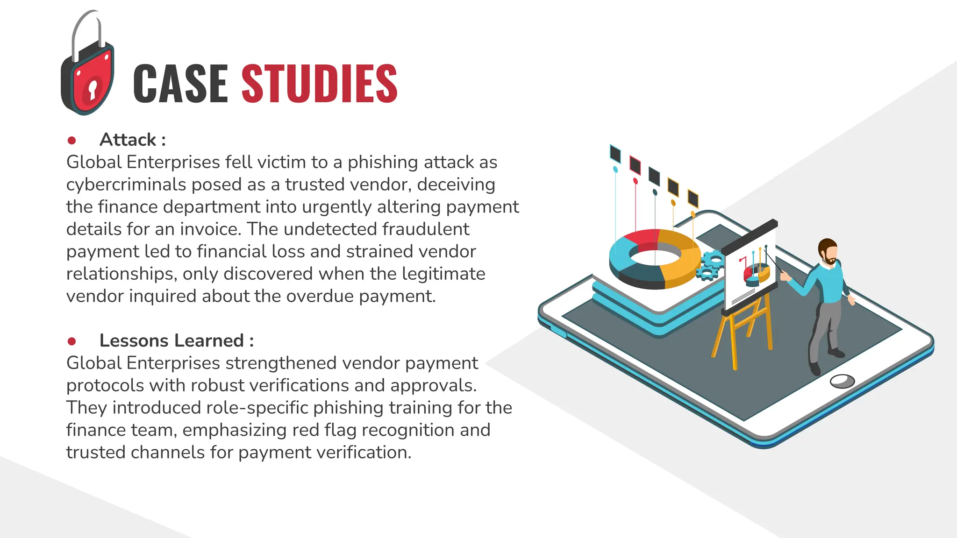

Slide 11
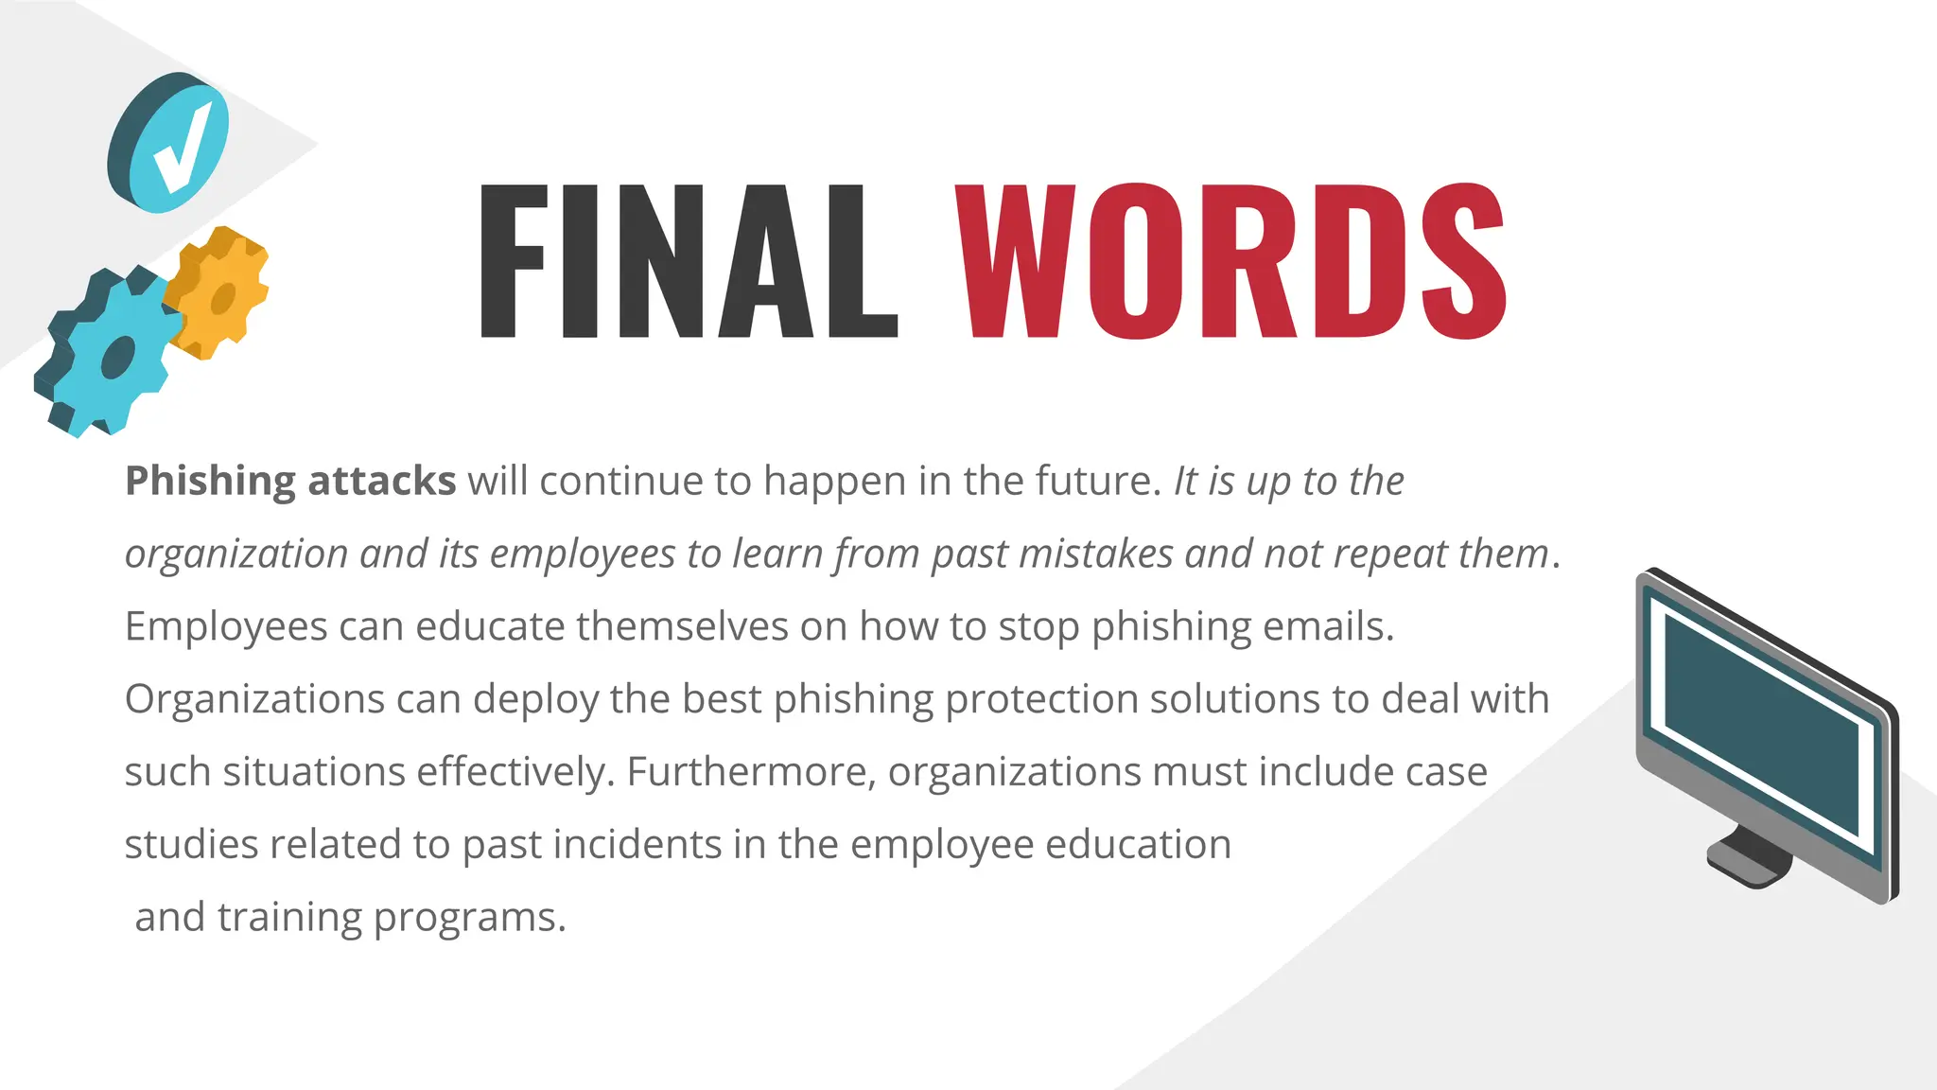

Slide 12
